Slide 1


DEPARTMENT OF COMPUTER SCIENCE ENGINEERING
Project name : TRAFFIC MANAGEMENT SYSTEM
Team name : Proj_224783_Team_2
Team members : 1.Praajeet M R(113321104076)
2.Peddu Venkata Pavan Kumar(113321104074)
3.Pragadesh R(113321104077)
4.Praveen J(113321104078)

Slide 2
PROJECT
A Traffic Management System (TMS) is a comprehensive set of integrated technologies, strategies, and practices designed to monitor, control, and optimize the flow of traffic on road networks. Its primary goal is to enhance traffic safety, efficiency, and sustainability. Here's an overview of the key components and functions of a typical Traffic Management System:
Traffic Monitoring and Data Collection:
Sensors, cameras, and other monitoring devices are deployed across the road network to gather real-time data on traffic conditions, including vehicle counts, speeds, and congestion levels.
Data Processing and Analysis:
Advanced algorithms process the collected data to identify traffic patterns, forecast trends, and detect anomalies. This analysis helps in making informed decisions about traffic control strategies
Traffic Control Center:
A centralized control center serves as the nerve center of the system. It's staffed by traffic management personnel who oversee the operation, monitor data feeds, and make real-time adjustments to traffic signals and controls.

Slide 3
Project Requirement
Sensors and Devices:
Traffic cameras: High-resolution cameras for monitoring traffic conditions.
Vehicle detection sensors: Inductive loop sensors, ultrasonic sensors, or radar sensors to detect the presence of vehicles.
Communication Infrastructure:
High-speed internet connectivity for data transmission.
Mesh network or LoRaWAN for connecting IoT devices over long distances.
Data Storage and Management:
Cloud-based storage for collecting and analyzing data.
Databases to store historical traffic data.
Real-time data processing and analytics for traffic insights

Slide 4
Traffic Control and Automation:
Centralized traffic management system for real-time decision-making.
Adaptive traffic signal control algorithms for optimizing signal timing.
Traffic prediction models to anticipate congestion and reroute traffic.
User Interface:
Web or mobile applications for traffic management personnel.
Public-facing applications for commuters to access real-time traffic information.
User-friendly dashboards with maps and traffic data
Security and Privacy:
Implement robust security measures to protect data and devices from cyber threats.
Ensure compliance with privacy regulations when collecting and using data.

Slide 5
Code Implementation
import random
import time
def generate_traffic_data():
return {
"location": "Intersection A",
"traffic_flow": random.randint(0, 100),
"weather": "Clear",
}
def control_traffic_lights(data):
if data["traffic_flow"] > 50:
print("High traffic flow. Adjusting traffic lights for green signal.")
while True:
traffic_data = generate_traffic_data()
print("Traffic Data:", traffic_data)
control_traffic_lights(traffic_data)
time.sleep(5)

Slide 6
Code explanation
Creating a complete traffic management system is a complex task that involves various components such as sensors, databases, user interfaces, and possibly hardware integration. Below, I'll provide a basic Python code outline for a simple traffic light simulation. Keep in mind that this is a simplified example and doesn't cover all aspects of a real-world traffic management system.
Keep in mind that this is a basic simulation and does not interact with any physical hardware or real-world data. For a complete traffic management system, you would need to incorporate things like sensors, actuators, databases, user interfaces, and potentially even machine learning algorithms for more advanced traffic management.
If you are working on a larger project, consider breaking it down into smaller, manageable parts, and start by implementing each component one by one. Additionally, you may want to look into libraries like Flask or Django for building web interfaces, and consider using external libraries for interfacing with hardware components if necessary.

Slide 7
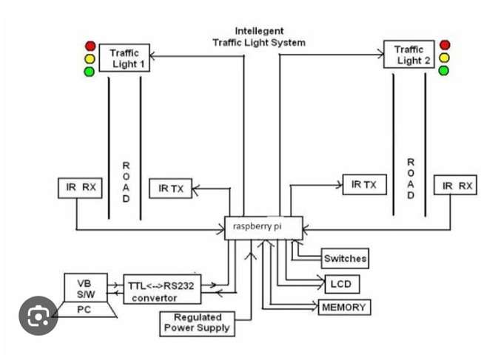
RASPBERRY PI INTEGRATION

Slide 8
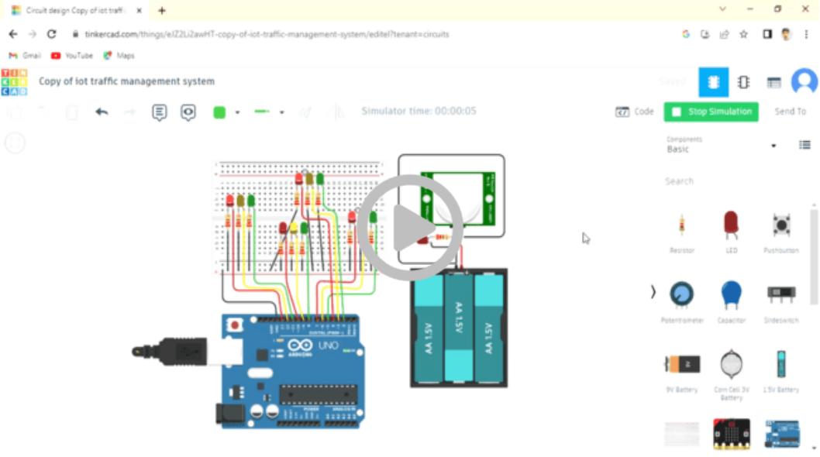
Implementation and Simulation
(watch the stimulation video below)

Slide 9
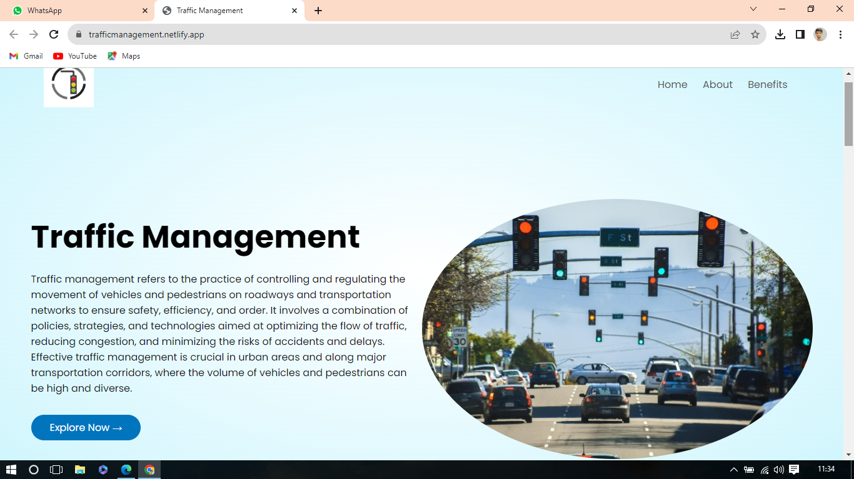
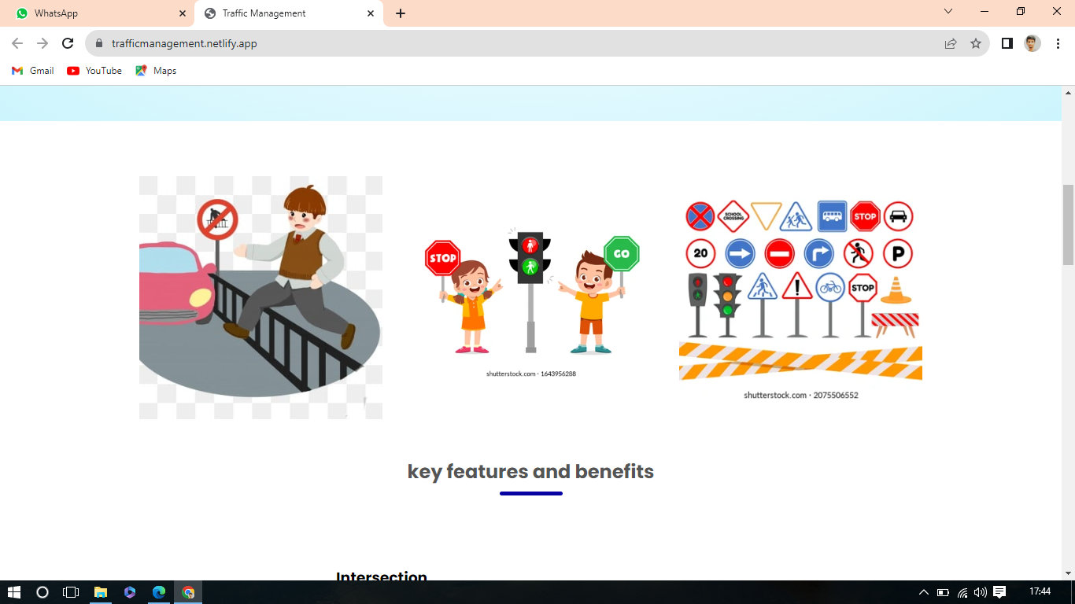
Click here to check our website​

Slide 10
CONCLUSION
In conclusion, a well-implemented traffic management system is essential for enhancing road safety, reducing congestion, and improving overall transportation efficiency. Through the use of advanced technology, data analytics, and smart infrastructure, such systems have the potential to transform urban mobility and make our roads safer and more accessible for everyone. However, their success depends on continuous investment, maintenance, and adaptation to the evolving needs of our cities and transportation networks. With a commitment to innovation and collaboration between government authorities, technology providers, and the public, we can create a more sustainable and efficient future for urban transportation.

Slide 11
THANK YOU!

